Slide 1
Architectural Engineering: Structural Option
Thesis Presentation
Best Buy Main Corporate Campus: Building D
Richfield, MN
Jonathan E. Aberts
Spring 2009

Slide 2
Presentation Outline
Introduction
  Building description
  Existing structural conditions
Project Proposal
Building Redesign
  Columns
  PT floor system
  Lateral system
  Foundation
Cost Comparison
Architectural Comparison
Conclusions

Slide 3
Introduction
Building Name: Best Buy Main Corporate Building
Location: Richfield, MN
Function: Office building
Occupants: Best Buy corporate employees
Architects: Perkins & Will (www.perkinswill.com)
    Minneapolis, MN
Engineers: Opus Northwest (www.opuscorp.com)
    Minnetonka, MN
CM: Opus Northwest
    Chris Johnson

Slide 4
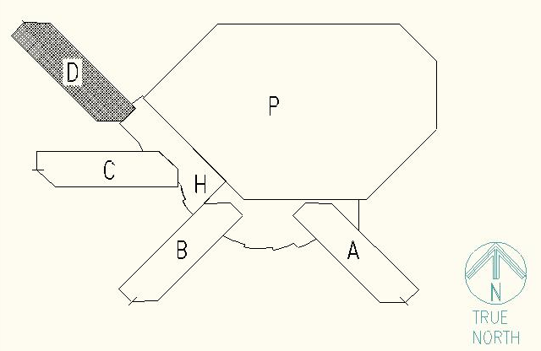
Introduction

Slide 5
Building Description
Architecture
Precast curtain wall
Ribbon windows
Curtain wall consists of 6” architectural precast panels tied into the steel structure
Prefinished aluminum closure panel holds the ribbon of windows on each floor

Slide 6
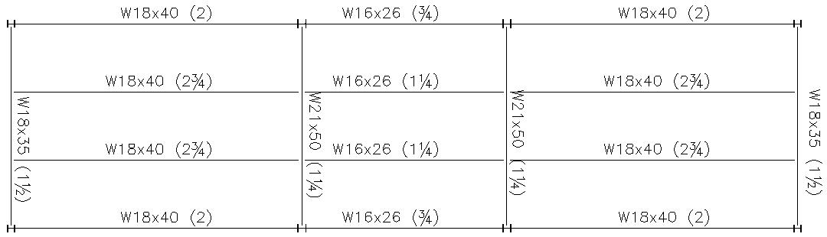
Structural System
Floor System
Composite beam framing system
6¼” slab, 3” 20 gauge deck and 3¼” lightweight concrete
Spray on fireproofing

Slide 7
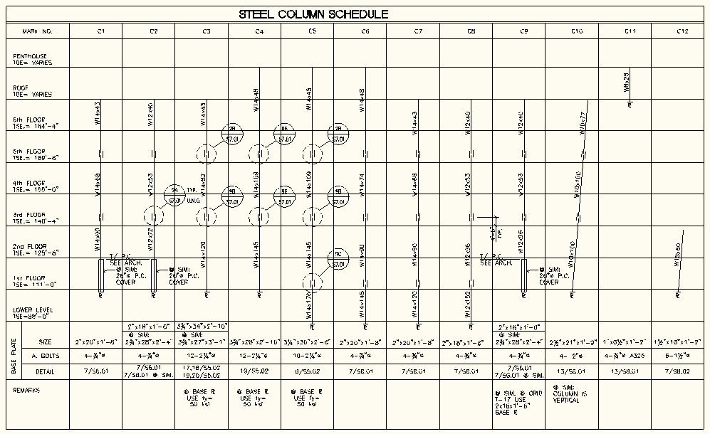
Structural System

Slide 8
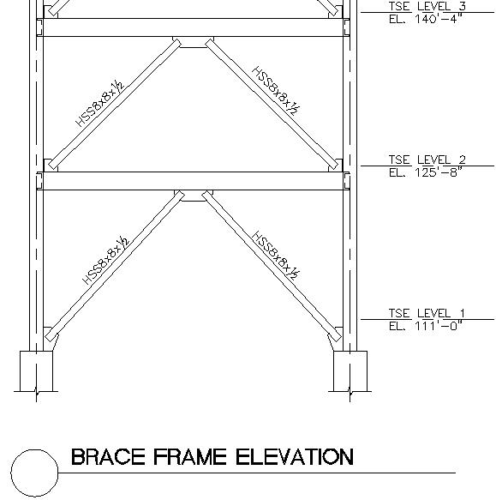
Structural System
Lateral System
Braced frame consist of 3 - W14 columns spliced together at the 3rd and 5th floors
Heavier beams, W16x57

Slide 9
Project Proposal
Proposed Solution:
Redesign Best Buy Corporate Building D as a full concrete system
Floor system will be redesigned post-tensioned slab with beams
Columns will also be redesigned into concrete
Lateral bracing system will be shear walls
Goal is to allow for a larger bay size in the short direction of the building
Cost Comparison of structural system
The impact of the change in architecture on the tenant and rentable area

Slide 10
Project Proposal
Solution Method:
Utilize ACI 318-05 Building Code Requirements for Structural Concrete
Utilize ADAPT-PT to design beams and slab
Utilize PCA Column and ETABS to design columns and shear walls
Utilize RS Means Building Construction Cost Data for a structural cost analysis
Compare and contrast new vs. old architecture

Slide 11
Building Redesign
Columns
PT floor system
PT beams
Shear Walls
Foundation

Slide 12
Columns
Design floor layout to support larger bays with fewer columns
PCA Columns aided in design of reinforcement
ETABS used to verify column sizing

Slide 13
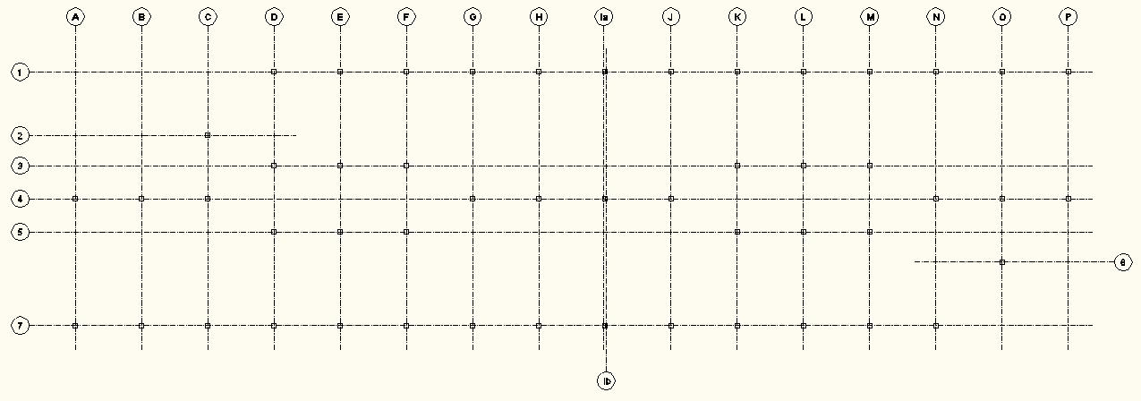
Columns

Slide 14
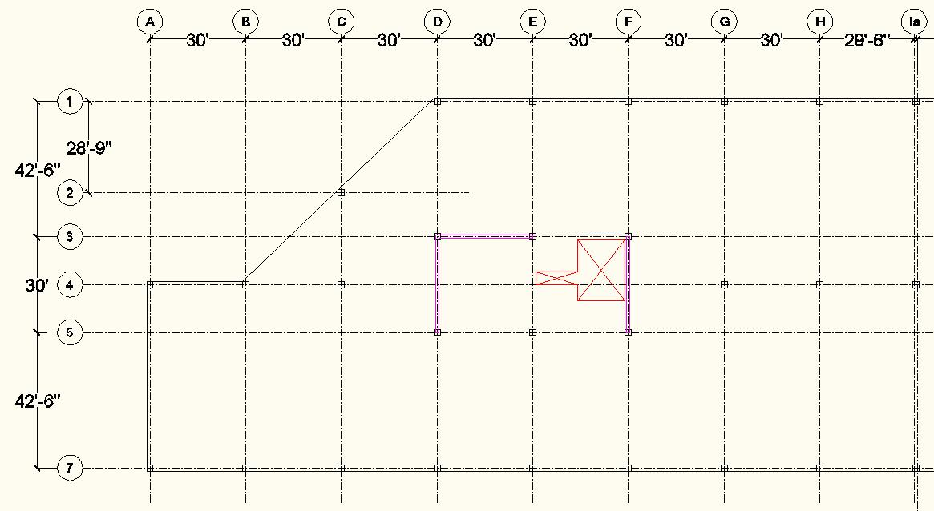
Columns

Slide 15
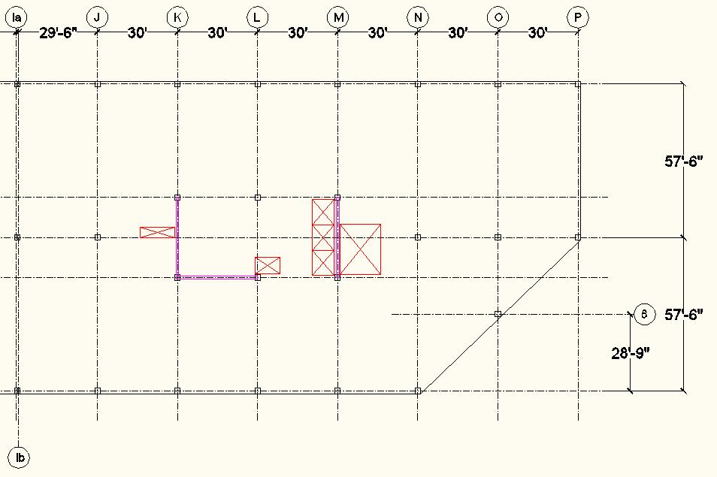
Columns

Slide 16
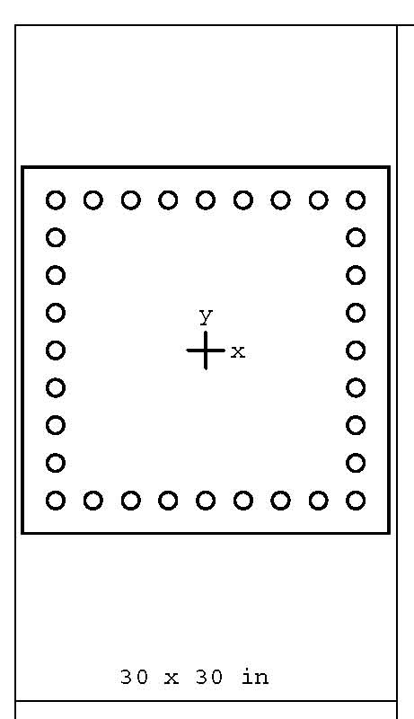
Columns
30”x30” columns requiring 32-#11 vertical reinforcing
24”x24” columns requiring 28-#11 vertical reinforcing

Slide 17
Post-tensioned Slab
Design post-tensioned slab using ADAPT-PT as an aid
Keep slab thickness close to 8” as recommended by span/depth ratio

Slide 18
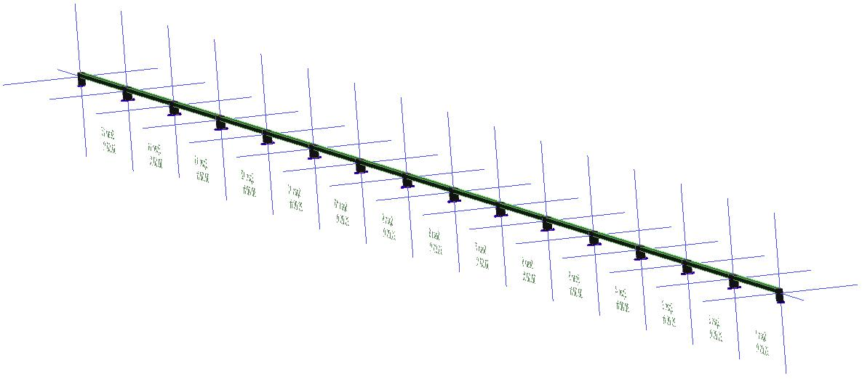
Post-tensioned Slab

Slide 19
Post-tensioned Slab
Unit strip method
Determined a 9.5” slab was required
2 tendons required for first and last 2 spans
1 tendon for the remaining spans

Slide 20
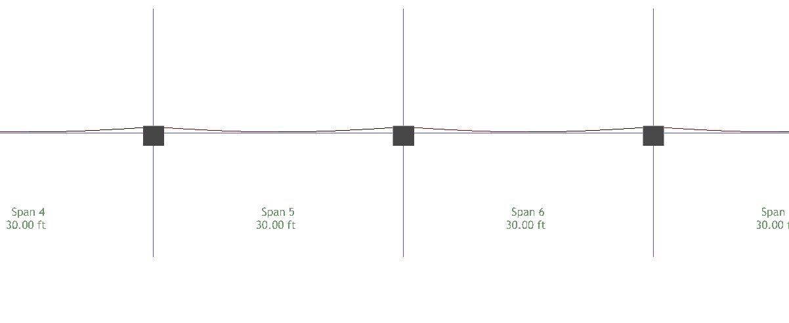
Post-tensioned Slab

Slide 21
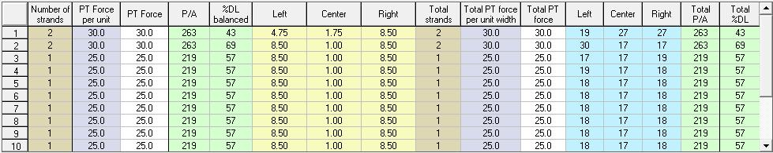
Post-tensioned Slab

Slide 22
Post-tensioned Beams
Design post-tensioned beam using ADAPT-PT as an aid
Keep beam thickness close to 27” as recommended by span/depth ratio

Slide 23
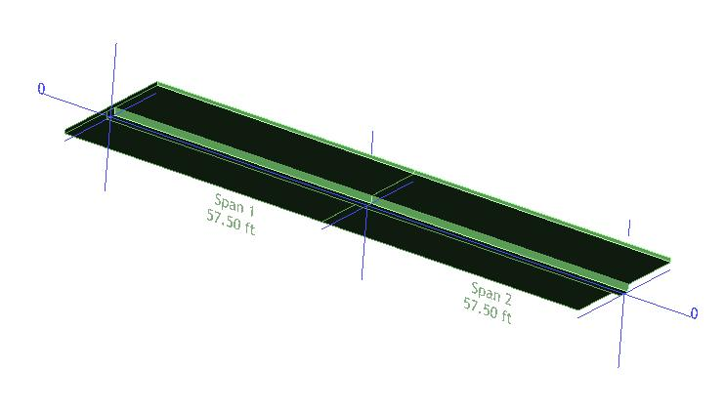
Post-tensioned Beams

Slide 24
Post-tensioned Beams
2 different beams had to be designed
  2 span (57’6”,57’6”)
  3 span (42’6”,30’,42’6”)
Designed 28” deep for both spans
27 tendons needed for 2 span and 19 tendons for 3 span

Slide 25
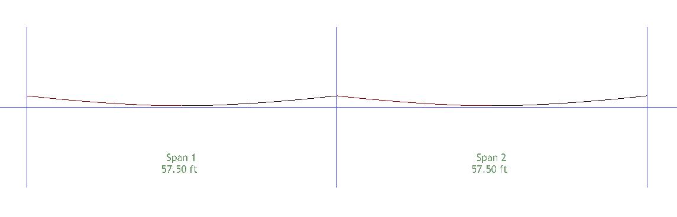
Post-tensioned Beams

Slide 26
Post-tensioned Beams

Slide 27
Lateral System
Redesign braced frames into shear walls while maintaining current location

Slide 28
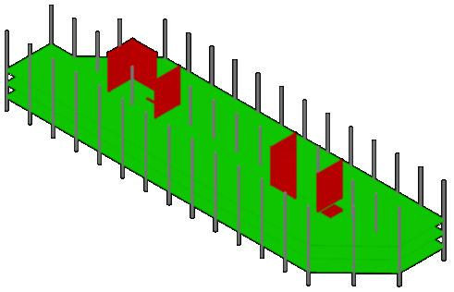
Lateral System

Slide 29
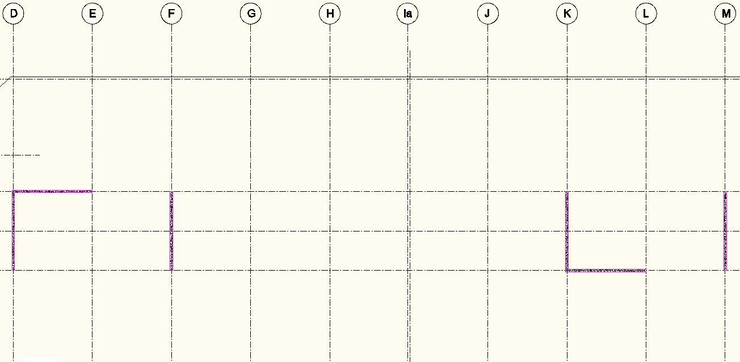
Lateral System

Slide 30
Lateral System
ETABS assisted in the design
Found that a 12” wall was a sufficient thickness
Boundary elements were designed to fit inside the 12” wall

Slide 31
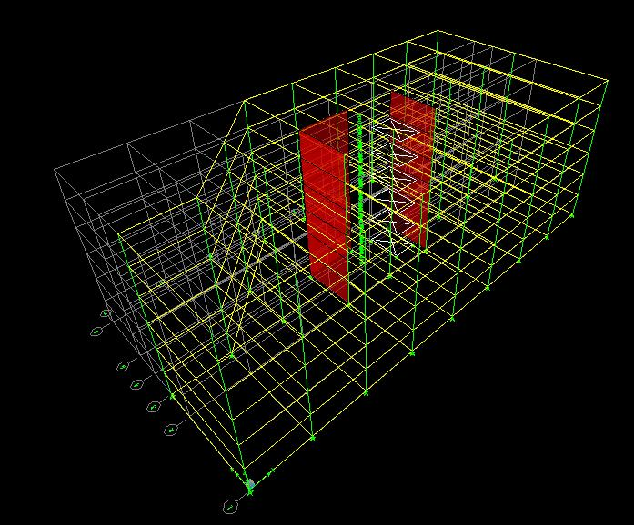
Lateral System

Slide 32
Foundation
Considered, however, not redesigned
Heavier concrete columns and shear walls
  Larger piers and slabs
  Stronger concrete

Slide 33
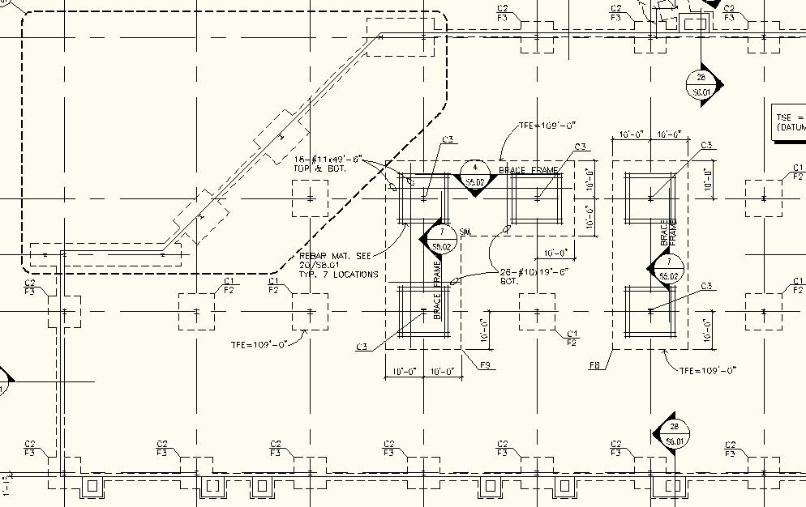
Foundation

Slide 34
Cost Analysis
Beams and Girders
Size | Quantity | Average Length | Cost per ft | Cost per Floor
W8x15 | 3 | 10 | $37.00 | $1,110.00
W12x14 | 8 | 10 | $36.00 | $2,880.00
W12x19 | 5 | 15 | $36.00 | $2,700.00
W14x22 | 2 | 13 | $47.00 | $1,222.00
W16x26 | 42 | 30 | $53.00 | $66,780.00
W16x31 | 1 | 30 | $63.50 | $1,905.00
W16x57 | 4 | 30 | $98.50 | $11,820.00
W18x35 | 25 | 30 | $81.00 | $60,750.00
W18x40 | 81 | 42.5 | $72.00 | $247,860.00
W21x44 | 1 | 34 | $87.50 | $2,975.00
W21x50 | 27 | 30 | $98.50 | $79,785.00
W24x55 | 3 | 33.2 | $107.00 | $10,657.20
W24x62 | 1 | 30 | $121.00 | $3,630.00
 |  | Total Cost per Floor |  | $494,074.20
 |  | Total Building Cost |  | $2,964,445.20

Slide 35
Cost Analysis
Slab |  | Columns |  |  | Beams
Depth | Area | # of | Height | Area | # of | Length | Area
0.83 | 46575 | 51 | 11.84 | 6.25 | 16 | 115 | 4.72
Total (c.y.) |  | Total (c.y.) |  |  | Total (c.y.)
1431.75 |  | 139.78 |  |  | 321.66
Cast-in-Place Concrete
Cost per c.y. | Cost per c.y. | Cost per c.y.
610 | 1375 | 1200
Cost per Floor | Cost per Floor | Cost per Floor
$873,367.50 | $192,194.44 | $385,991.11
CIP Costs per Floor
$1,451,553.06
Total Building CIP Costs
$8,709,318.33

Slide 36
Cost Comparisons
A considerable increase in costs of materials and erection
38%
 | Beam | Columns | Floor System | Total
Steel | $2,964,445.20 | $909,422.64 | $2,443,540.96 | $6,317,408.80
Concrete | $2,315,946.67 | $1,153,166.67 | $5,240,205.00 | $8,709,318.33

Slide 37
Architecture Comparisons
Increased open space bays from 42’6” to 57’6”
No fireproofing
Fewer columns for partitioned rooms to work around

Slide 38
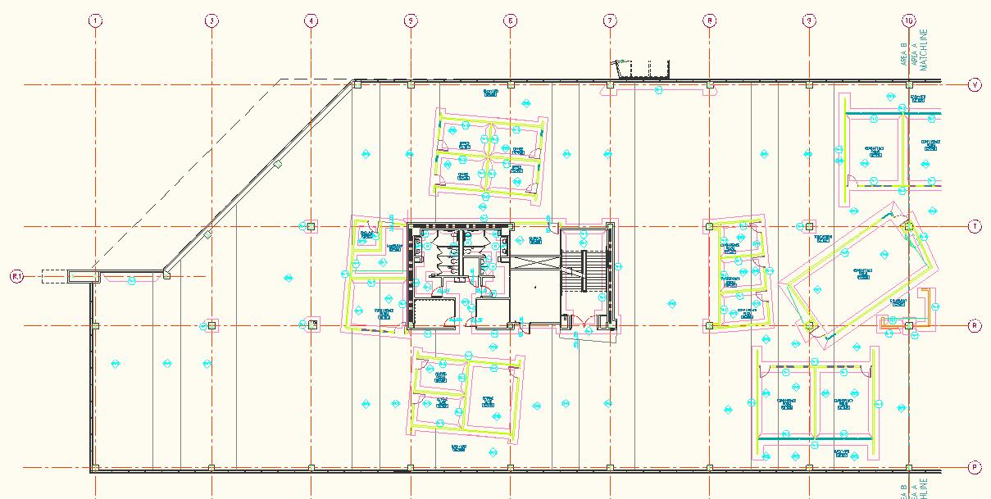
Architecture Comparisons

Slide 39
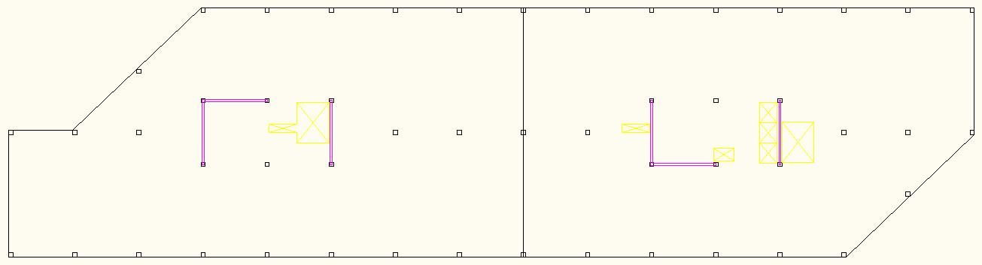
Architecture Comparisons

Slide 40
Conclusions
New floor system increased bay sizes without sacrificing ceiling/floor height
Cost of new system far exceeds cost of existing system

Slide 41
Acknowledgements
Thesis Advisors:
  Dr. Thomas E. Boothby
Industry Contacts:
  Gary R. Strand, P.E. - Simpson Gumpertz & Heger
  David B. Smith, P.E. - Holbert Apple Associates
  Richard Apple, P.E. - Holbert Apple Associates
Other Mentors:
  Professor M. Kevin Parfitt
  Professor Moses Ling

Slide 42
Questions
?

